Slide 1

What is Project Scope Management? (1 of 3)
n Scope refers to all the work involved in creating the products of the project and the processes used to create them
Defining scope of a project is very important but difficult aspect of PM
n A deliverable is a product produced as part of a project. It can beproduct related such as hardware or software, or process related such as a
planning document or meeting minutes
n Project scope management includes the processes involved in defining and controlling what is or is not included in a project. It ensures the
project team and stakeholders have the same understanding of
i. what products the project will produce
ii. what processes the project team will use to produce them
2

Slide 2
What is Project Scope Management? (2 of 3)
n Six main processes
1. Planning scope management: determine how the project’s scope and requirements will be managed
2. Collecting requirements: define and document the features and functions of the products produced during the project as well as the processes used for creating them
3. Defining scope: create a scope statement by reviewing the project charter, requirements documents, and organizational process assets
4. Creating the work breakdown structure (WBS): subdivide the major project deliverables into smaller, more manageable components
5. Validating scope: formalize acceptance of the project deliverables
6. Controlling scope: control changes to project scope throughout the life of the project
3

Slide 3
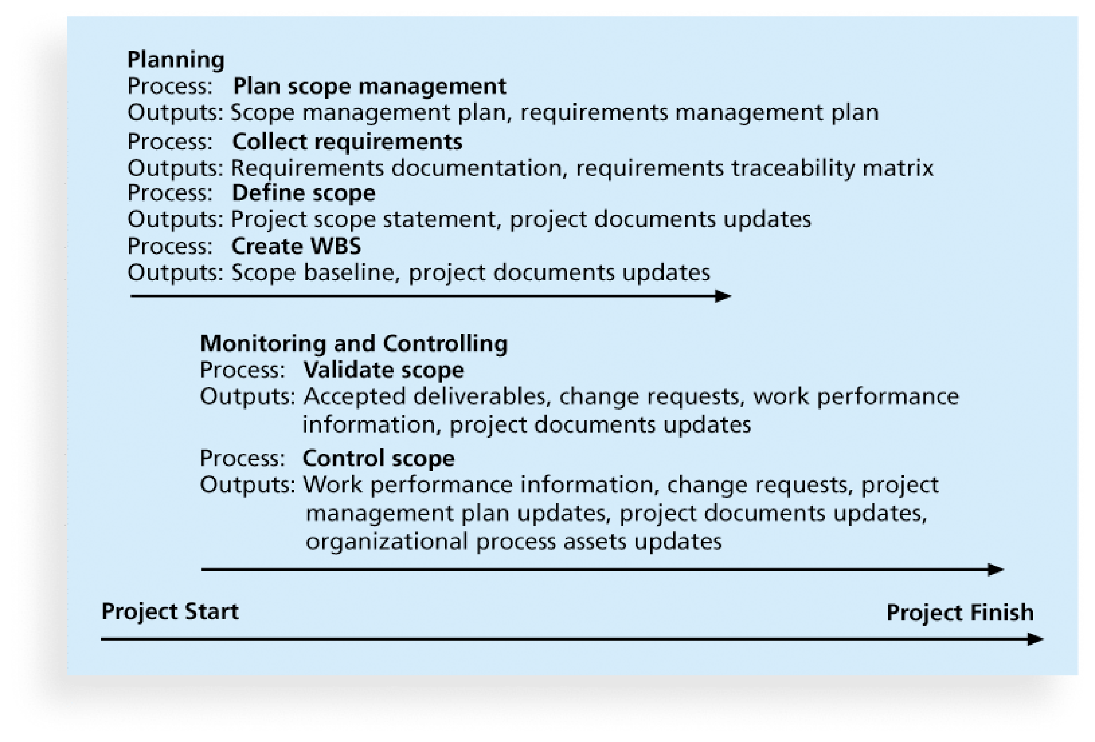
What is Project Scope Management? (3 of 3)
4

Slide 4
1. Planning Scope Management (1 of 3)
n The 1st step of scope management is to plan how the scope of the project will be managed throughout its life cycle
n The project team uses expert judgment, data analysis, and meetings to develop two important outputs: 1) scope management plan, and 2)
requirements management plan
n Scope management plan is subsidiary part of the project management plan. In general, it includes the following information:
i. How to prepare a detailed project scope statement
ii. How to create, approve, and maintain a WBS
iii. How to obtain formal acceptance of the completed project deliverables
iv. How to control requests for changes to the project scope
5

Slide 5


1. Planning Scope Management (2 of 3)
n A requirement is defined as “a condition or capability that is necessary to be present in a product, service, or result to satisfy a business need”
Requirements include the quantified and documented needs and expectations of the sponsor, customer, and other stakeholders
n Requirements need to be elicited（引出）, analyzed, and recorded in enough detail to be included in the scope baseline and to be measured once project execution begins
For software projects, it is helpful to divide requirements development into the software engineering steps called EASV (Elicitation, Analysis,
Specification, and Validation)
n Important to use an iterative approach to defining requirements because they are often unclear at the early stage of a project
6

Slide 6


1. Planning Scope Management (3 of 3)
n Requirements management plan (RMP) documents how the project requirements will be analyzed, documented, and managed
n RMP can include the following information:
How to plan, track, and report requirements activities
How to perform configuration management activities
How to prioritize requirements
How to use product metrics
How to trace and capture attributes of requirements
7

Slide 7

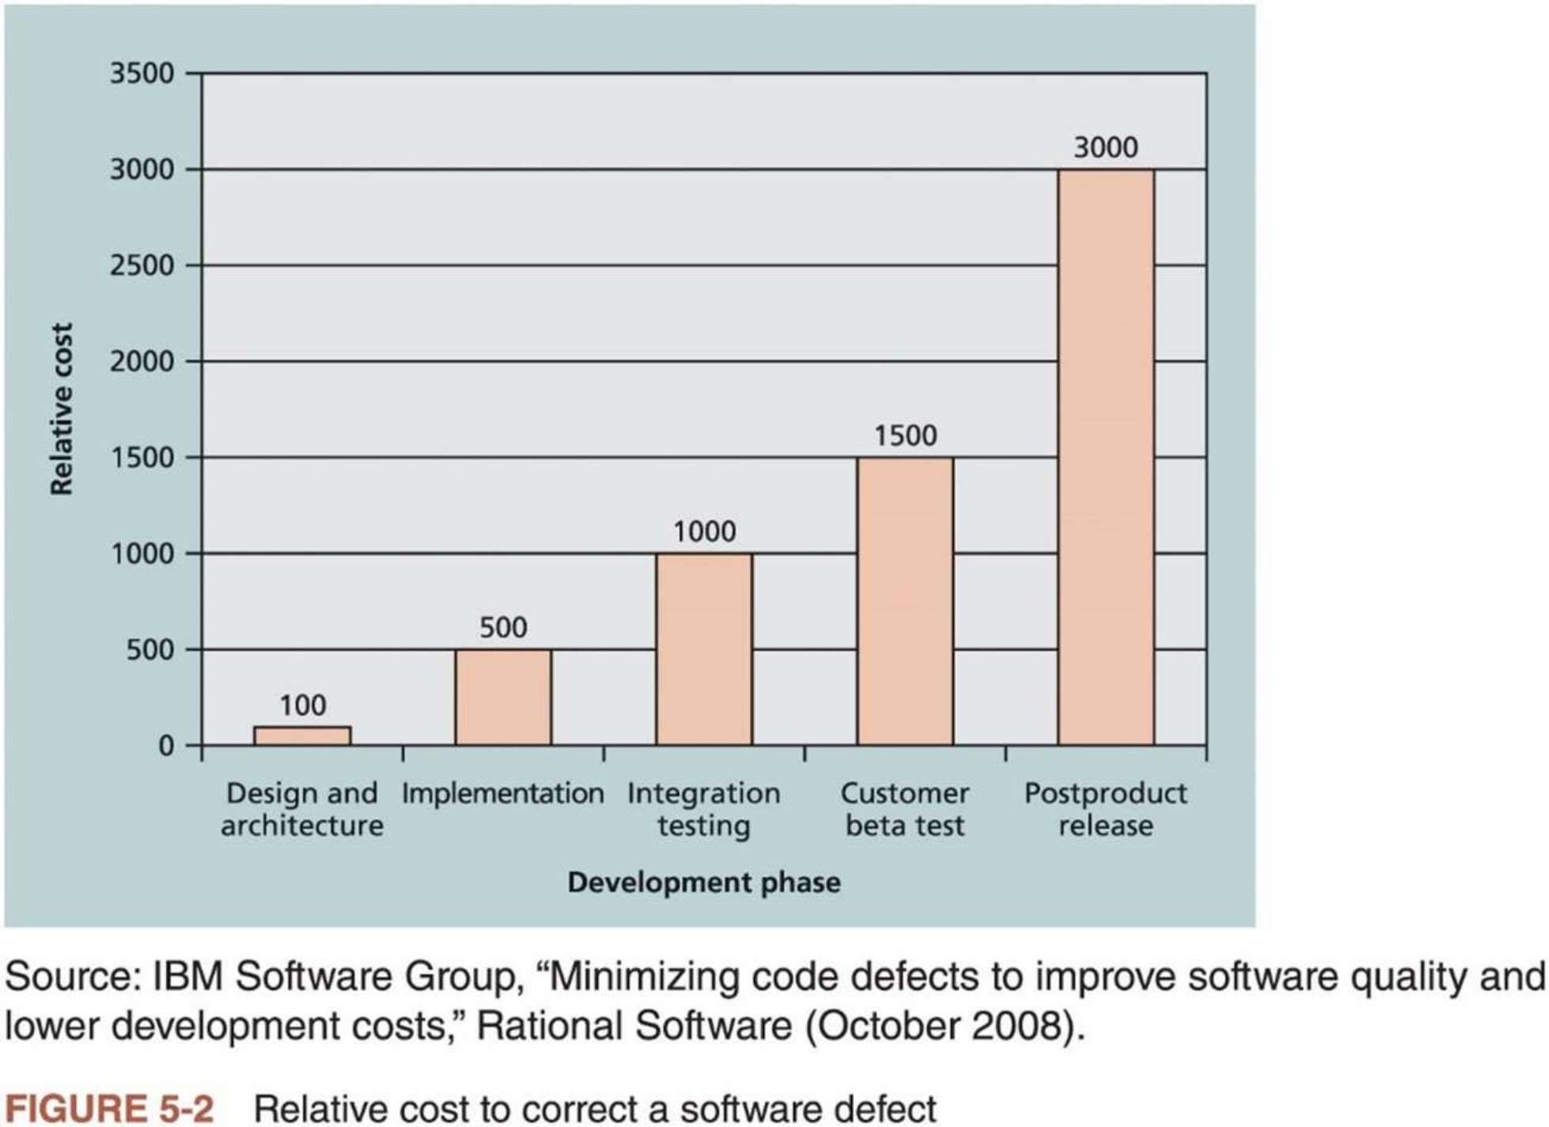
2. Collecting Requirements (1 of 4)
n The 2nd step, collecting requirements, is often the most difficult in project scope management
A major consequence of not doing it well is rework, which can consume up to half of project costs, especially for software development projects
8

Slide 8

2. Collecting Requirements (2 of 4)
n Important to understand requirements as early as possible
Defining and implementing requirements is one of the most challenging aspects of project scope management
n Several ways to collect requirements
i. Interviewing stakeholders
ii. Holding focus groups and facilitated workshops
iii. Using group creativity and decision-making techniques
iv. Questionnaires and surveys
v. Conducting observation studies
vi. Generating ideas by comparing specific project practices or product characteristics (i.e., benchmarking)
9

Slide 9



2. Collecting Requirements (3 of 4)
n Some statistics (refer to textbook for more details)
88% of the software projects involved enhancing existing products instead of creating new ones
73% of respondent said that the most important challenge for their teams was gaining a clear understanding of what customers wanted, followed by documenting and managing requirements
75% of respondents were managing projects with at least 100 requirements; 20% were managing projects with over 1,000 requirements
70% of respondents spent at least 10% of their time managing changes to requirements; 30% spent more than 25% of their time on such changes
n The project’s size, complexity, importance, and other factors affect how much effort is spent on collecting requirements
10

Slide 10


2. Collecting Requirements (4 of 4)
n Ways to document the requirements (refer to textbook for details)
Requirements are often broken down into different categories such as
functional requirements, service requirements, performance requirements, quality requirements, and training requirements.
Format of documents can range from a list ofall requirements on a single piece of paper to a room full of notebooks
n Requirements traceability matrix (RTM) is a table that lists requirements, various attributes of each requirement, and the status of the requirements to ensure that all requirements are addressed
Requirement No. | Name | Category | Source | Status
R32 | Laptop memory | Hardware | Project charter and corporate laptop specifications | Complete. Laptops ordered meet memory requirement.
Table 5-1 Sample entry in a requirements traceability matrix
11

Slide 11

3. Defining Scope (1 of 4)
n The 3rd step in project scope management is to provide a detailed definition of the work required for the project
n Good scope definition is very important to project success
i. Helps improve the accuracy of time, cost and resource estimates
ii. Defines a baseline for performance measurement and project control
iii. Aids in communicating clear work responsibilities
n Main outputs
project scope statement and project documents updates
n Main tools and techniques used in defining scope
Expert judgment, data analysis, decision making, interpersonal and team skills, and product analysis
12

Slide 12

3. Defining Scope (2 of 4)
n A project scope statement should include at least
i. Product scope description
ii. Product user acceptance criteria
iii. Detailed information on all project deliverables
n Helpful to document other scope-related information, such as project boundaries, constraints, and assumptions
n The project scope statement should reference supporting documents, such as product specifications and corporate policies
Many IT projects require detailed functional and design specifications for developing software, which should be referenced in the detailed scope
statement
n As time progresses, the scope of a project should become clearer and more specific
13

Slide 13

3. Defining Scope (3 of 4)
n Table 5-3 provides an example of how the scope becomes progressively more detailed in scope statements labeled Version 1 and Version 2
Project Charter: Upgrades may affect servers . . . (listed under Project Objectives)
Servers: If additional servers are required to support this project, they must be compatible with existing servers. If it is more economical to enhance existing servers, a detailed description of enhancements must be submitted to the CIO for approval. See current server specifications provided in Attachment 6. The CEO must approve a detailed plan describing the servers and their location at least two weeks before installation.
Servers: This project will require purchasing 10 new servers to support Web, network, database, application, and printing functions. Virtualization will be used to maximize efficiency. Detailed descriptions of the servers are provided in a product brochure in Attachment 8, along with a plan describing where they will be located.
Project Scope Statement, Version 1:
Project Scope Statement, Version 2:
Table 5-3 Further defining project scope
14

Slide 14


3. Defining Scope (4 of 4)
n Project scope statements often refer to related documents, such as product specifications and brochures, or other plans
n As more information becomes available and decisions are made related to project scope, the project team should update the project scope
statement
The team might name different iterations of the scope statement Version 1, Version 2, and so on
These updates may also require changes to other project documents. For
example, if the company must purchase servers from a new supplier, the
procurement management plan should include information on working with that new supplier.
n An up-to-date scope statement is important for developing and confirming a common understanding of the project scope
15

Slide 15

Media Snapshot
n Inaccurate requirements gathering continues to be one of the main causes of project failure
n Organizations lacking the resources and maturity in requirements management will pay a price
n A PMI report in 2014 on requirements management (see textbook for details)
“For every dollar spent on projects and programs, 5.1% is wasted due to poor requirements management. Put in more striking terms, this amounts to US$51 million wasted for every US$1billion spent. That’s a lot of potential value
falling through the cracks in the project-driven world.”
It suggests that organizations need to develop people, processes, and culture to improve requirements management
16

Slide 16


4. Creating WBS (1 of 9)
n The 4th step in project scope management is to create a work breakdown structure (WBS)
WBS is a deliverable-oriented grouping of the work involved in a project that defines the total scope of the project
n WBS is a foundation document that provides the basis for planning and managing project schedules, costs, resources, and changes
Because WBS defines the total scope of the project, some experts believe that work should not be done on a project if it is not included in the WBS. Therefore, it is crucial to develop a complete WBS.
n Primary inputs for creating a WBS
PM plan
Project documents
Enterprise environmental factors
Organizational process assets
17

Slide 17

4. Creating WBS (2 of 9)
n Decomposition is a main tool or technique for creating a WBS, that is, subdividing project deliverables into smaller pieces
A work package is a task at the lowest level ofthe WBS (see more discussions later)
n Outputs of creating the WBS are the scope baseline and project documents updates
Scope baseline includes the approved project scope statement and its associated WBS and WBS dictionary
n WBS is often depicted as a task-oriented tree of activities, like an organizational chart
Many people like to create a WBS in chart form first to visualize the whole project and all its main parts
18

Slide 18
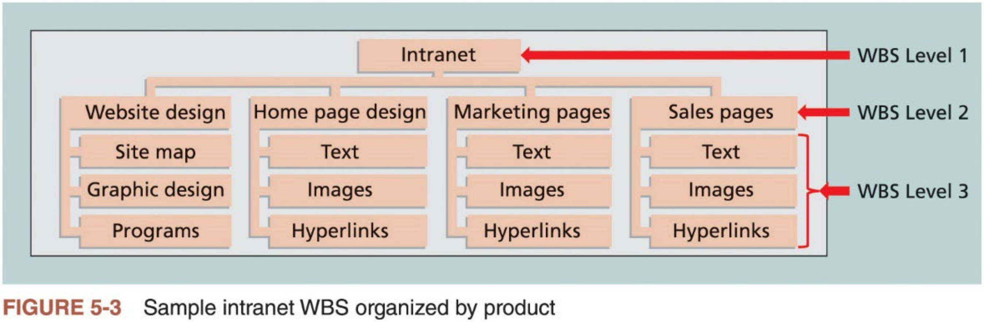
4. Creating WBS (3 of 9)
n Figure 5-3 shows a WBS for an intranet project
The top box “Intranet” represents the entire project --- Level 1 ofWBS
The main products “Website design”, “Home page design”, “Marketing pages”, and “Sales pages” to be delivered are shown in Level 2 ofWBS
Below each of a Level-2 item are Level-3 items ofWBS
19

Slide 19

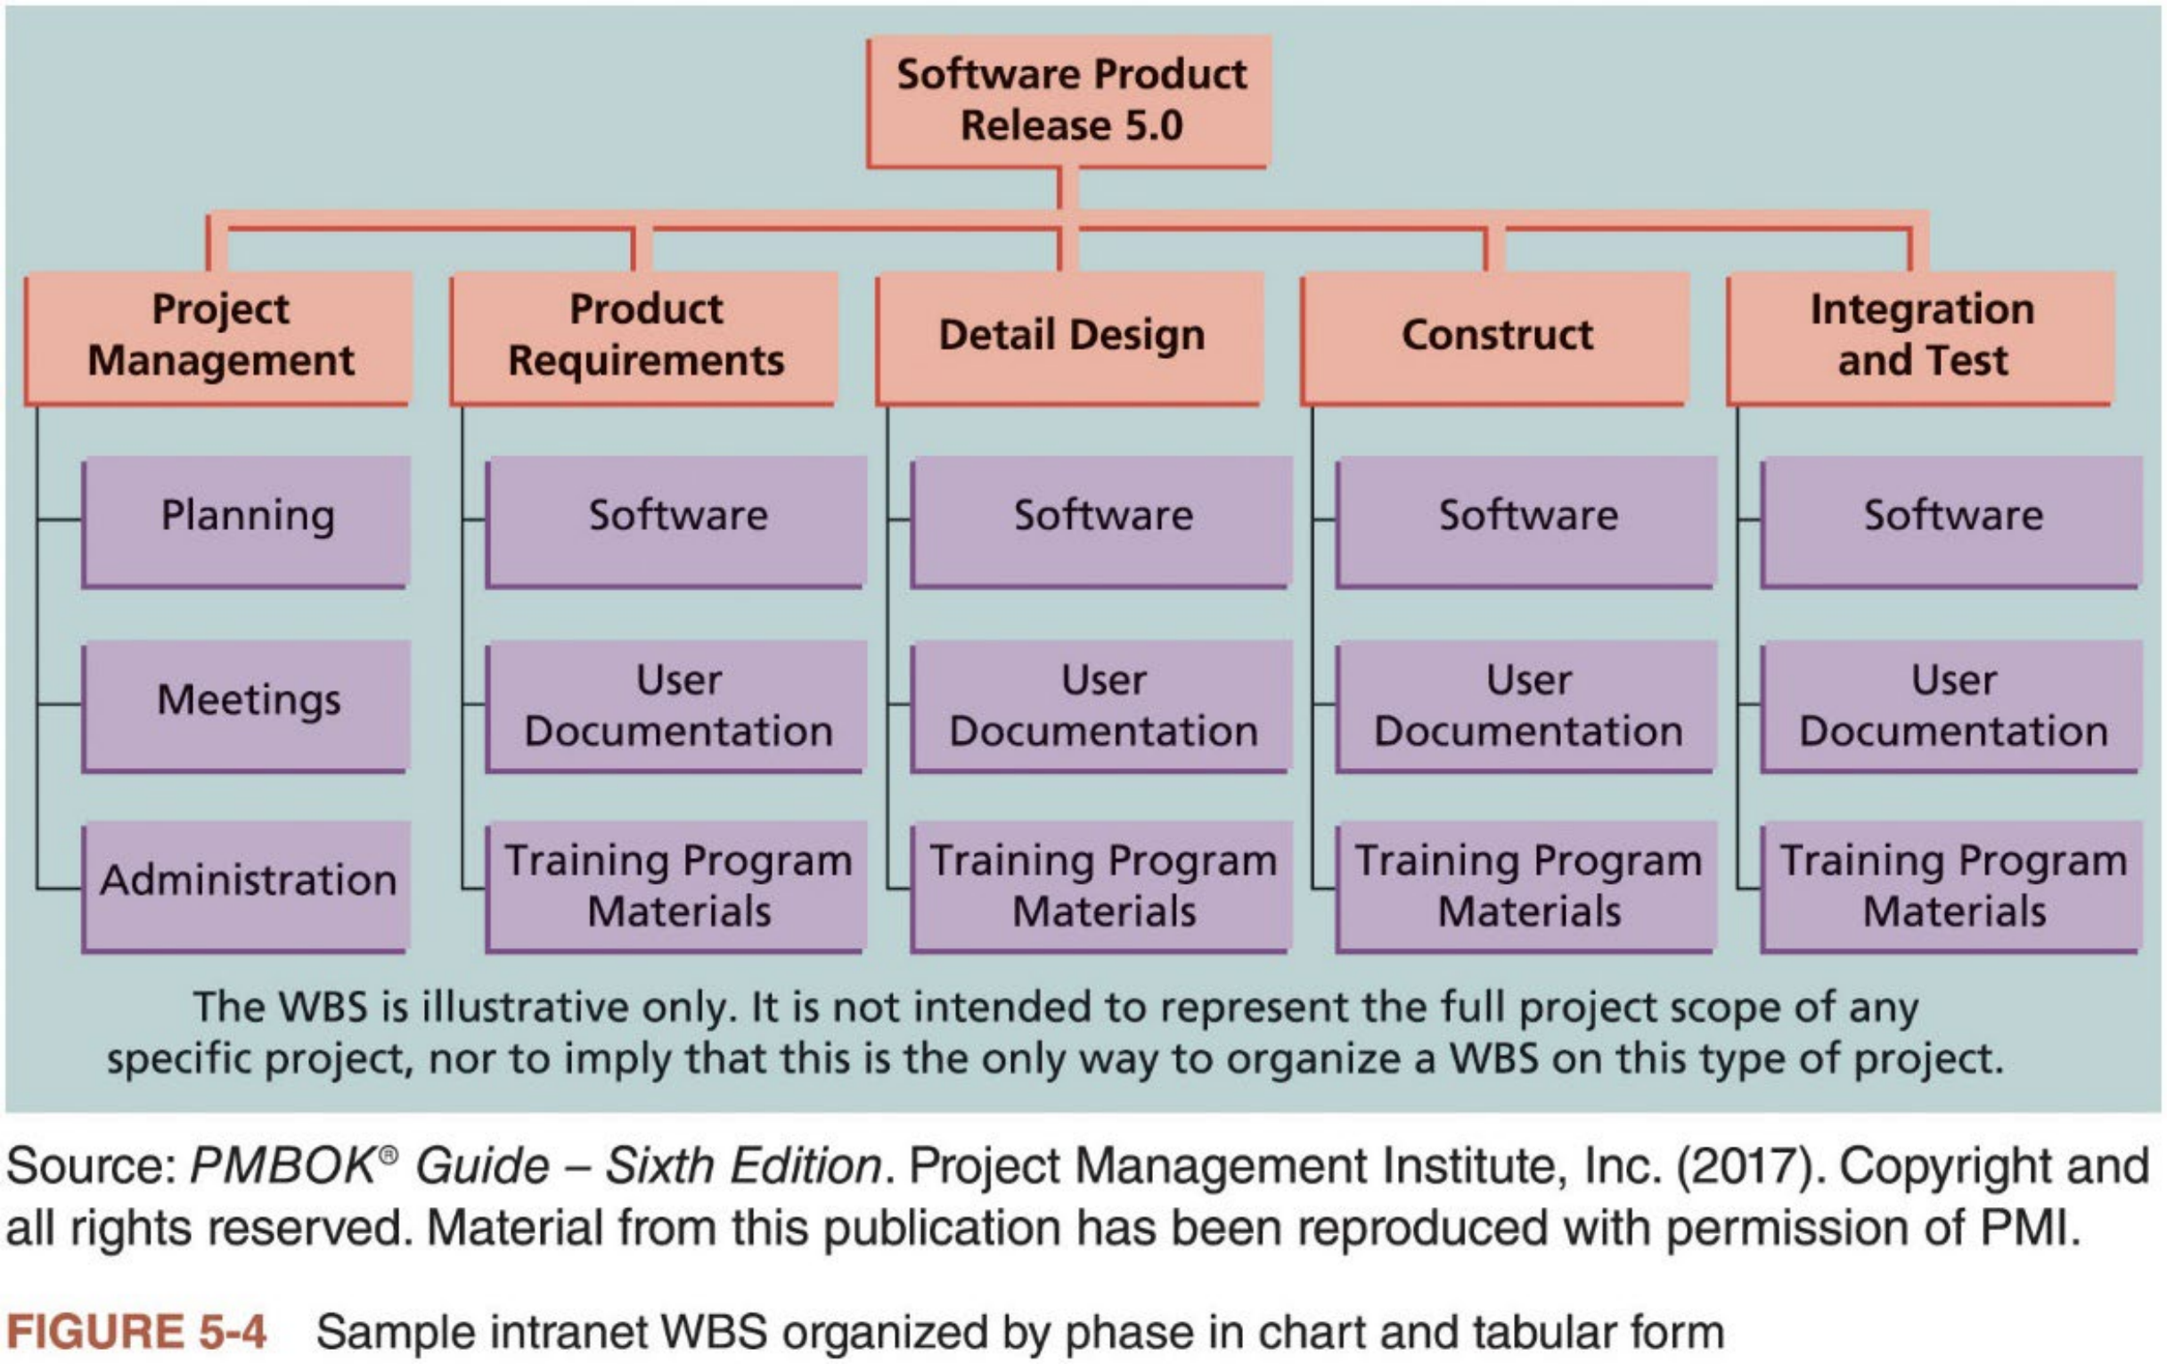
4. Creating WBS (4 of 9)
n Figure 5-4 shows a software product release project created by PMI
Level 2 is organized around deliverables for each project phase as well as another level-2 item for project management
20

Slide 20
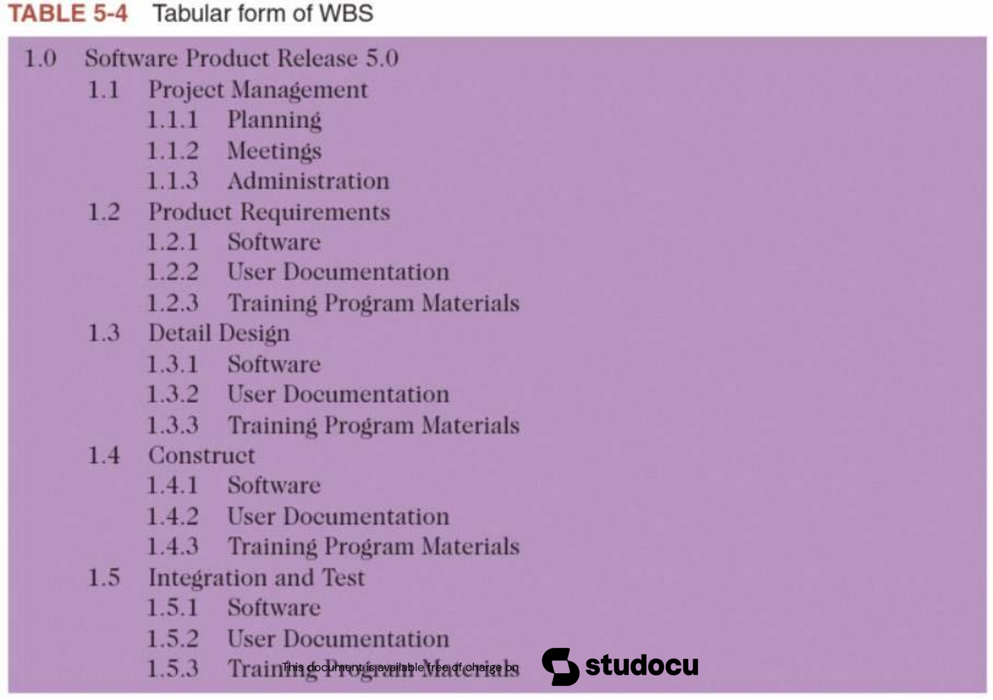
4. Creating WBS (5 of 9)
n Table 5-4 shows the same WBS in a tabular or list format
21

Slide 21


4. Creating WBS (6 of 9)
n Many documents, such as contracts, use the tabular format, but the numbering scheme may vary
PM software also uses the tabular format
Important to decide on a numbering scheme and use it when referring to WBS items
n Also decide how you will name WBS items. Some organizations use only nouns to focus on describing deliverables, as PMI recommends
For example, name a WBS item “requirements definition”, instead of “define requirements”
n The main purpose of the WBS is to define all the work required to
complete a project, so focus on that while following your organization’s structural guidelines.
22

Slide 22


4. Creating WBS (7 of 9)
n A work package is a task at the lowest level ofthe WBS, and represents the level of work that the project monitors and controls
You can think of work packages in terms of accountability and reporting
If a project has a short (resp., very long) duration and requires weekly (resp., quarterly) progress reports, a work package might represent work completed within a week (resp., in one month or more)
n A work package should be defined at the proper level so that the project manager can clearly
i. establish an estimate of the effort needed to complete
ii. estimate the cost of all required resources
iii. evaluate the quality of the results when the work package is finished
n When using PM software, estimates of work time should be entered only at the work package level
23

Slide 23
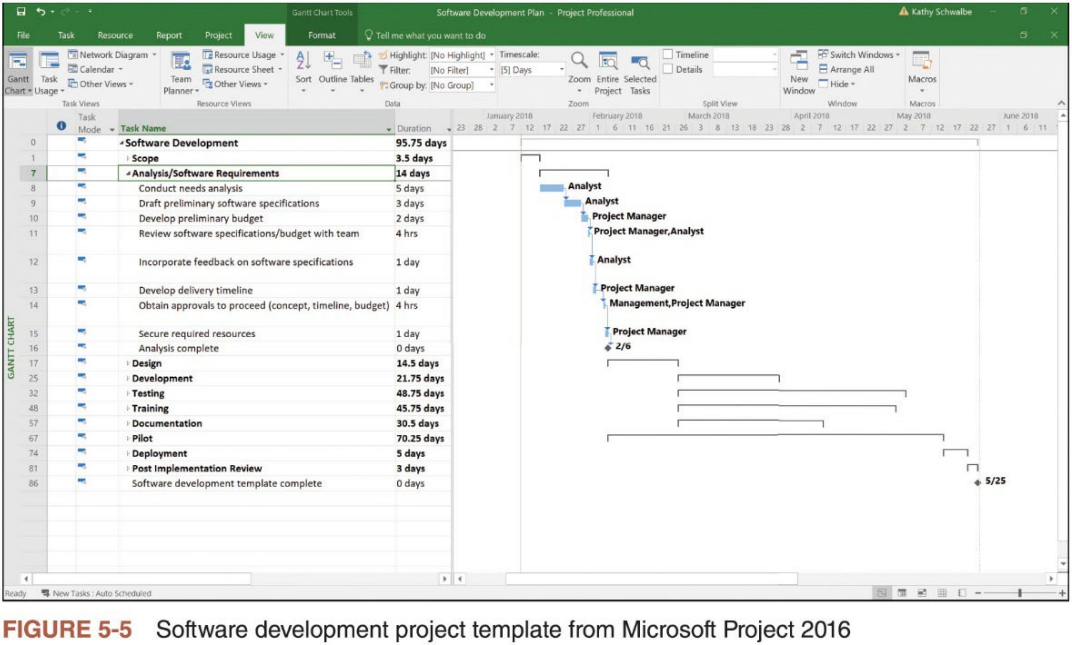
4. Creating WBS (8 of 9)
WBS is the basis for creating Gantt Chart
24

Slide 24




4. Creating WBS (9 of 9)
n Very difficult to create a good WBS
The project team must understand the project and its scope and incorporate the needs and knowledge of the stakeholders
The project team must decide as a group how to organize the work and how to include many levels in the WBS
n Creating WBS is aimed to offset project risk by considering the project’s details in advance of their execution
More accurate estimates of scope, time, and cost are obtained when the project is defined appropriately and in sufficient detail
Operating at too high a level increases project risk
n All work should be included in the WBS, including project management
n Very important to involve the entire project team and the customer in creating and reviewing WBS
25

Slide 25
Approaches to Developing WBS
n Several approaches can be used to develop a WBS
i. Using guidelines: many organizations provide guidelines for preparing WBSs
ii. Analogy approach: review WBSs of similar projects and tailor to your project
iii. Top-down approach: start with the largest items of the project and break them into subordinate items
iv. Bottom-up approach: start with many specific tasks, and aggregate and
organize them into summary activities, or higher levels in the WBS
v. Mind mapping: use branches radiating out from a core idea to structure thoughts and ideas
26

Slide 26


Using Guidelines
n Follow guidelines, if they exist, for developing a WBS
n Many organizations provide guidelines and templates for developing WBSs, as well as examples of WBSs from past projects
Microsoft Project comes with several templates, and more are available on Microsoft’s website and other sites
PMI developed a WBS Practice Standard to provide guidance for
developing and applying the WBS to PM. It includes sample WBSs for a wide variety of projects in various industries.
n Project managers and their teams should review related information to develop their unique project WBSs more efficiently
27

Slide 27



The Analogy Approach
n Analogy approach uses a similar project’s WBS as a starting point
For example, Kim Nguyen from the opening case in textbook might learn that one of her organization’s suppliers did a similar IT upgrade project last year. She could ask them to share their WBS for that project to provide a
starting point for her own project.
McDonnell Aircraft Company designed and manufactured several different fighter aircraft. When creating a WBS for a new aircraft design, it started by using 74 predefined subsystems for building fighter aircraft based on past
experience.
n Viewing WBSs from similar projects allows you to understand different ways to create a WBS
Some organizations keep a repository ofWBSs and other project documentation on file to assist people working on projects
Microsoft Project and many other software tools include sample files to assist users in creating a WBS and Gantt chart
28

Slide 28



Top-Down and Bottom-Up Approaches
n Top-down approach: start with the largest items of the project and break them into subordinate items. Most project managers consider this
approach to be conventional.
Involves refining the work into greater and greater levels of detail. Upon completion, all resources should be assigned at the work package level.
Best suited to project managers who have vast technical insight and a big- picture perspective.
n Bottom-up approach: start with many specific tasks related to the project as possible, and then aggregate and organize them into summary
activities, or higher levels in the WBS.
Often used for projects that represent entirely new systems or approaches to doing a job, or used to help create synergy with a project team
Can be very time consuming, but can also be very efficient
29

Slide 29

Mind Mapping (1 of 3)
n A technique that uses branches radiating out from a core idea to structure thoughts and ideas
It allows people to write and even draw pictures of ideas
This more visual, less structured approach to defining and then grouping
tasks can unlock creativity among individuals and increase participation and morale among teams
n Figure 5-7 shows a diagram created by MatchWare’s MindView software that uses mind mapping to create a WBS for the IT upgrade project from the opening case of textbook
Figure 5-8 shows the Gantt chart generated from the mind map
n After the mind-mapping documents are complete, you can convert them into a chart or tabular WBS form.
30

Slide 30
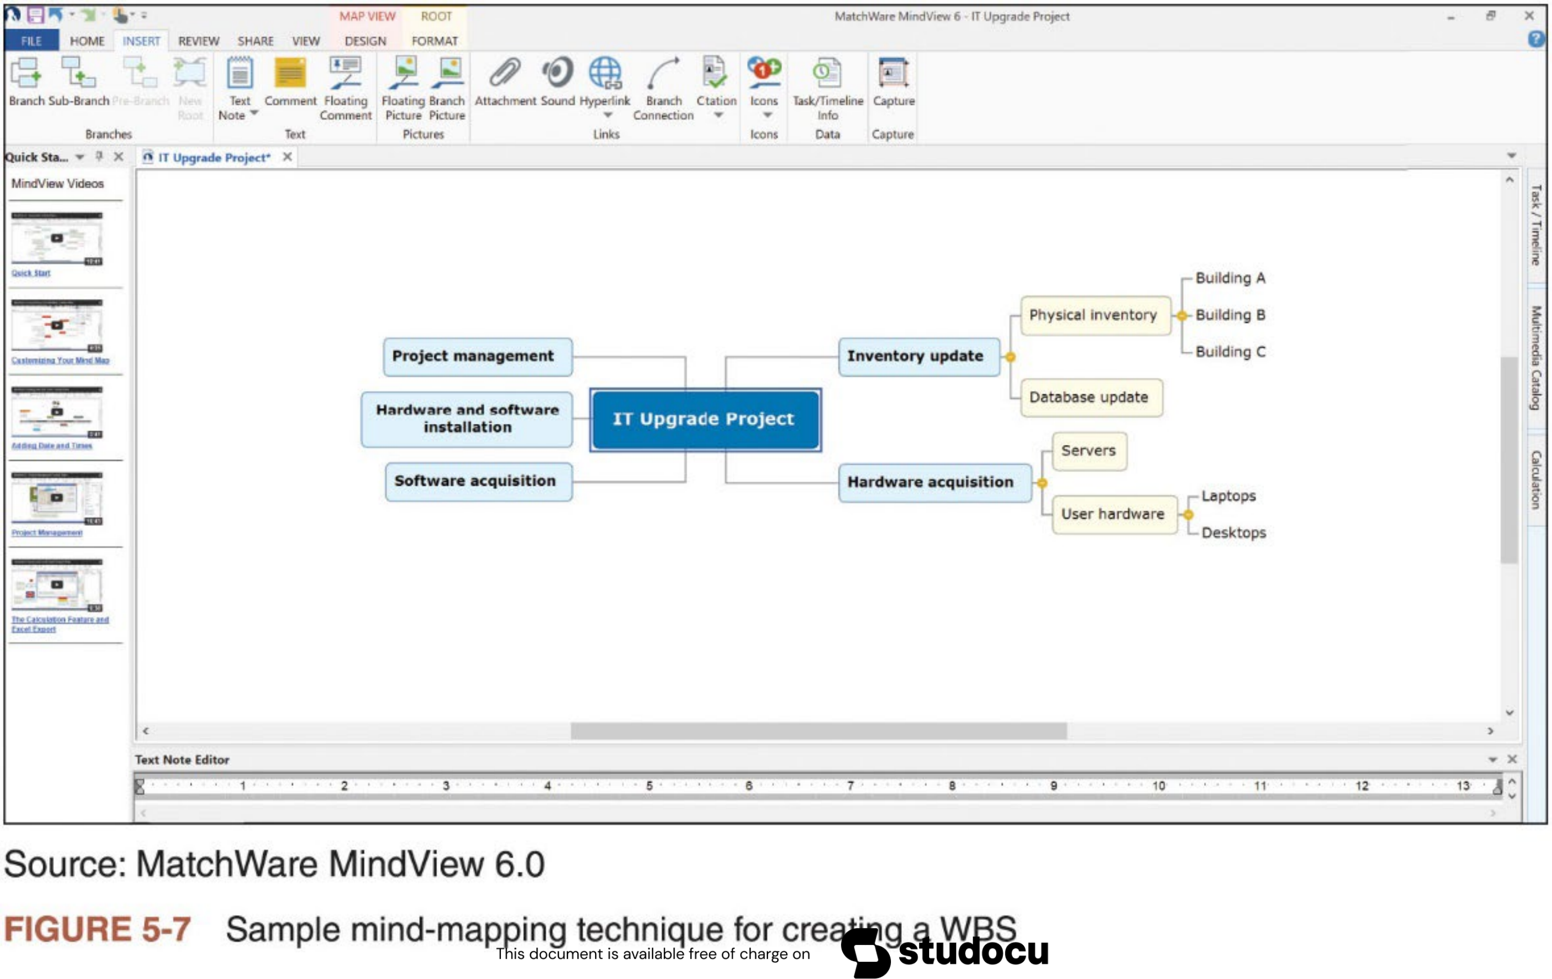
Mind Mapping (2 of 3)
31

Slide 31
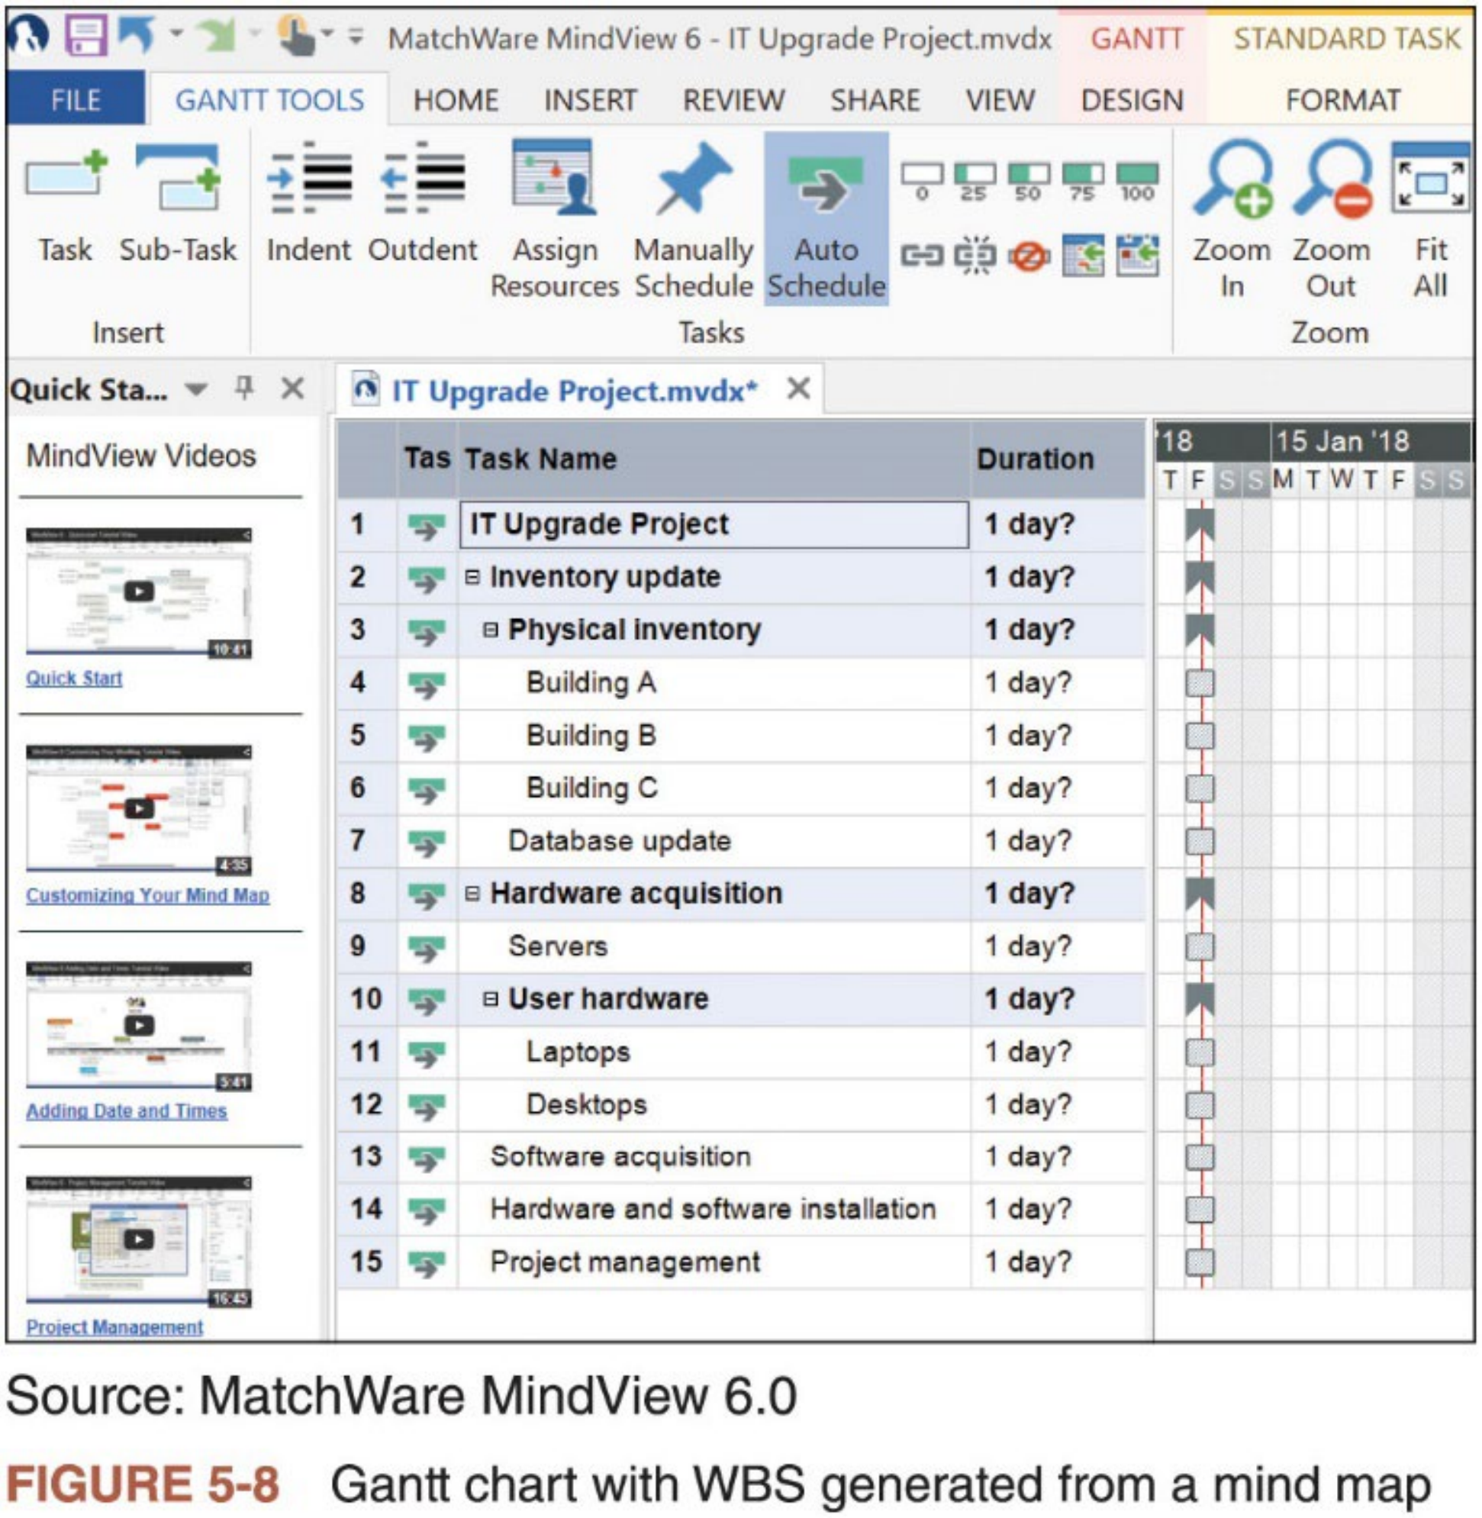
Mind Mapping (3 of 3)
32

Slide 32


WBS Dictionary (1 of 2)
n Many of the items listed in the WBS are very vague (without details)
n WBS dictionary is a document that describes detailed information about each WBS item
Definition of the work involved in the task -- a clarification & explanation that makes the summary description in the WBS easier to understand in
terms of the approach taken to complete the work.
n Format of the WBS dictionary can vary based on project needs
Project teams often review WBS dictionary entries from similar tasks to get a better idea of how to create their entries
n The approved project scope statement and its associated WBS and WBS dictionary form the scope baseline
Performance in meeting project scope goals is based on this scope baseline
33

Slide 33
WBS Dictionary (2 of 2)
WBS Dictionary Entry March 20
Project Title: Information Technology (IT) Upgrade Project
WBS Item Number: 2.2
WBS Item Name: Database Update
Description: The IT department maintains an online database of hardware and software on the corporate intranet. We need to make sure that we know exactly what hardware and software employees are currently using and if they have any unique needs before we decide what to order for the upgrade. This task will involve reviewing information from the current
database, producing reports that list each department’s employees and location, and updating the data after performing the physical inventory and receiving inputs from department managers. Our project sponsor will send a notice to all department managers to communicate
the importance of this project and this particular task. In addition to general hardware and software upgrades, the project sponsors will ask the department managers to provide information for any unique requirements they might have that could affect the upgrades. This task also includes updating the inventory data for network hardware and software. After updating the inventory database, we will send an e-mail to each department manager to verify the information and make changes online as needed. Department managers will be responsible for ensuring that their people are available and cooperative during the physical inventory. Completing this task is dependent on WBS Item Number 2.1, Physical Inventory, and must precede WBS Item Number 3.0, Hardware and Software Acquisition.
Table 5-6 Sample WBS dictionary entry
34

Slide 34
Advice for Creating WBS and WBS Dictionary
n Creating a good WBS is not an easy task and usually requires several
iterations. Often, it is best to use a combination of approaches to create a project’s WBS.
n Basic principles for creating good WBS and WBS dictionary
i. A unit of work should appear at only one place in the WBS.
ii. Work content of a WBS item is the sum ofthe WBS items below it.
iii. A WBS item is the responsibility of only one individual, even though many people may be working on it.
iv. WBS must be consistent with the way in which work is going to be performed; it should serve the project team first, and other purposes only if practical.
v. Project team members should be involved in developing the WBS to ensure consistency and buy-in.
vi. Each WBS item must be documented in a WBS dictionary to ensure accurate understanding of the scope of work included and not included.
vii. WBS must be a flexible tool to accommodate inevitable changes while properly maintaining control of the work content in the project according to the scope
statement
35

Slide 35

5. Validating Scope (1 of 2)
n It is difficult to create a good project scope statement and WBS for a
project. It is even harder, especially on IT projects, to verify the project scope（开发芯片） and minimize scope changes
n The project team must develop a process for scope validation that meets unique project needs
Careful procedures must be developed to ensure that customers are getting what they want, and the project team has enough time and resources to
produce the desired products and services.
n Many IT projects suffer from scope creep (范围蔓延) – the tendency for project scope to become bigger and bigger
Crucial to verify the project scope with users throughout the life cycle of the project and develop a process for controlling scope changes
36

Slide 36



5. Validating Scope (2 of 2)
n Configuration management (refer to Project Int. Mgmt.) and scope validation are crucial to minimize scope changes
n Scope validation involves formal acceptance of the completed project deliverables
Often achieved by customer inspection and sign-off on key deliverables
To receive formal acceptance of the project scope, the project team must develop clear documentation of the project’s products and procedures to evaluate whether they were completed correctly and satisfactorily
n Main inputs and outputs for scope validation
Main inputs: the PM plan, project documents, verified deliverables, and work performance data
Main outputs: accepted deliverables, change requests, work performance information, and project documents updates
37

Slide 37



What Went Wrong?
n A project scope that is too broad and grandiose (宏大) can cause severe problems
Scope creep and an overemphasis on technology for technology’s sake resulted in the bankruptcy of a large pharmaceutical firm, Texas-based FoxMeyer Drug in 1996.
In 2001, McDonald’s fast-food chain initiated a project to create an intranet that would connect its headquarters with all its restaurants to provide
detailed operational information in real time. After spending $170 million on consultants and initial implementation planning, McDonald’s realized that
the project was too much to handle and terminated it.
n Lack of user involvement is another major scope problem on IT projects
Read the textbook for an IT project in late 1980s which wasted millions of dollars developing a system that was not in touch with the way end users did their work (and they refused to use the system).
38

Slide 38




Global Issues
n Many countries have difficulties in controlling the scope of large projects, especially those that involve advanced technologies and many different
users
n For example, the state government of Victoria, Australia, introduced a public transportation smart card, called myki, in 2010. There were many problems in developing and implementing the smart card.
The $1.35 billion system became available on all forms of Melbourne public transportation in July 2010.
Users’ initial reactions to myki were mixed, with several reports of myki readers not working on trams.
After over 18 months since the myki rollout, 70 percent of users still used the old Metcard.
Metcard was planned to be phased out for good by the end of 2012. Two years after myki became the only ticket in town, frustrated commuters say the system is still riddled with issues.
39

Slide 39
6. Controlling Scope (1 of 3)
n Controlling scope involves managing changes to the project scope while keeping in mind project goals and business strategy
n Goals of scope control
i. Influence the factors that cause scope changes
ii. Ensure changes are processed according to procedures developed as part of integrated change control
iii. Manage changes when they occur
n An important tool is data analysis, including variance analysis
Variance is the difference between planned and actual performances (e.g., planned delivery vs. actual delivery)
n Outputs of scope control include work performance information, change requests, PM plan updates, and project documents updates
40

Slide 40
6. Controlling Scope (2 of 3)
n Lack of user input leads to problems with managing scope creep and controlling change
n Suggestions for improving user input (refer to the textbook for detailed discussions)
i. Develop a good project selection process and insist that sponsors are from the user organization
ii. Place users on the project team
iii. Conduct regular meetings with defined agendas
iv. Deliver something to users and sponsors on a regular basis
v. Do not promise to deliver what the team cannot deliver in a particular time frame.
vi. Locate users with the developers. People often get to know each other better by being in proximity.
41

Slide 41
6. Controlling Scope (3 of 3)
n Many IT projects have too many changes to their requirements,
especially during later stages ofthe project life cycle when it is harder to implement changes.
n Suggestions for reducing incomplete and changing requirements
i. Develop and follow a requirements management process
ii. Employ techniques such as prototyping, use case modeling, and JAD to get more user involvement
iii. Put requirements in writing and keep them current and readily available
iv. Create a requirements management database for documenting and controlling requirements
v. Provide adequate testing and conduct it throughout the project life cycle
vi. Review changes from a systems perspective
vii. Emphasize completion dates to help focus on what’s most important
viii. Allocate resources specifically for handling change requests
42

Slide 42
Complementary Reading
n Chapter 5 “Project Scope Management” of Schwalbe (2018)
n Chapter 5 “Project Scope Management” in Part 1 of PMBOK® Guide (2017)
43

